Slide 1
FISH270
Lecture 10

Slide 2
Defense

Slide 3
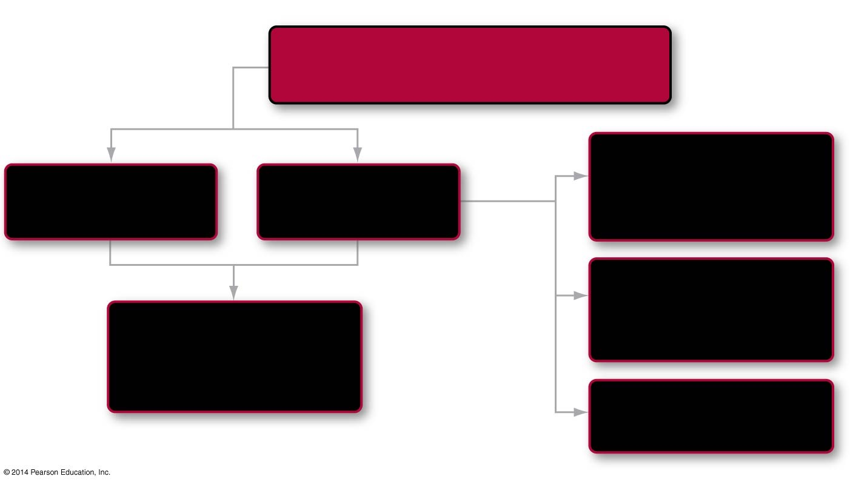
Roadmap 51
In this chapter you will learn how
Animals fight infectious diseases using their immune system
by first comparing
Recognition: the role of lymphocytes
Innate immunity
Adaptive immunity
51.1
looking closer at
51.2
finally asking
Activation: T cells and B cells
What happens when the immune system doesn’t work correctly?
51.3
51.5
Response and memory
51.4
Notes:
Chapter 51 Opening Roadmap.

Slide 4
Defense Systems
Anatomic Features
Immunity

Slide 5
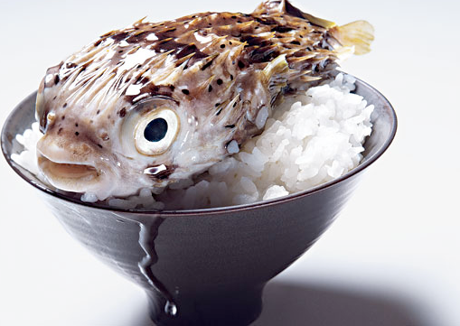
Anatomic Features

Slide 6
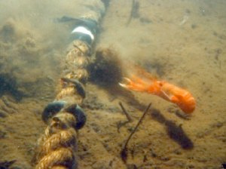
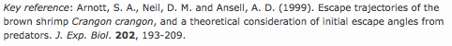
Anatomic Features

Slide 7
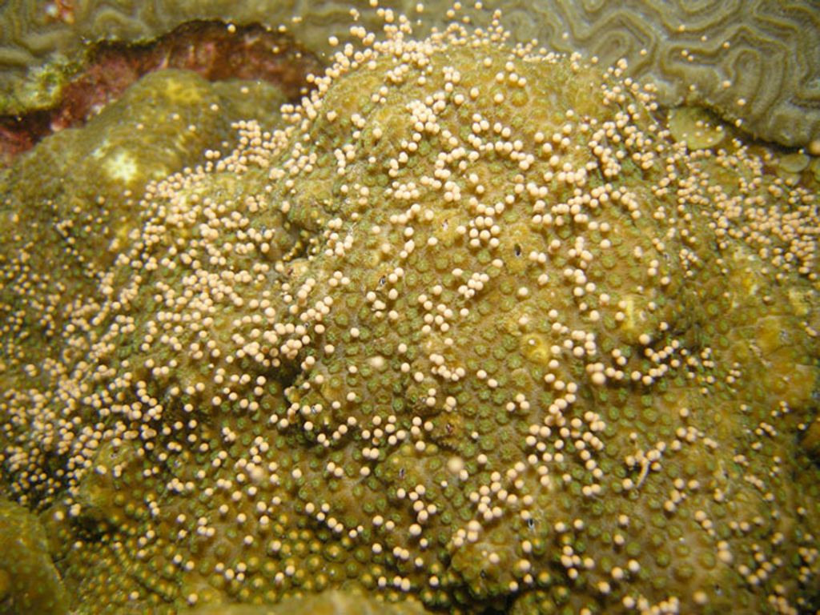
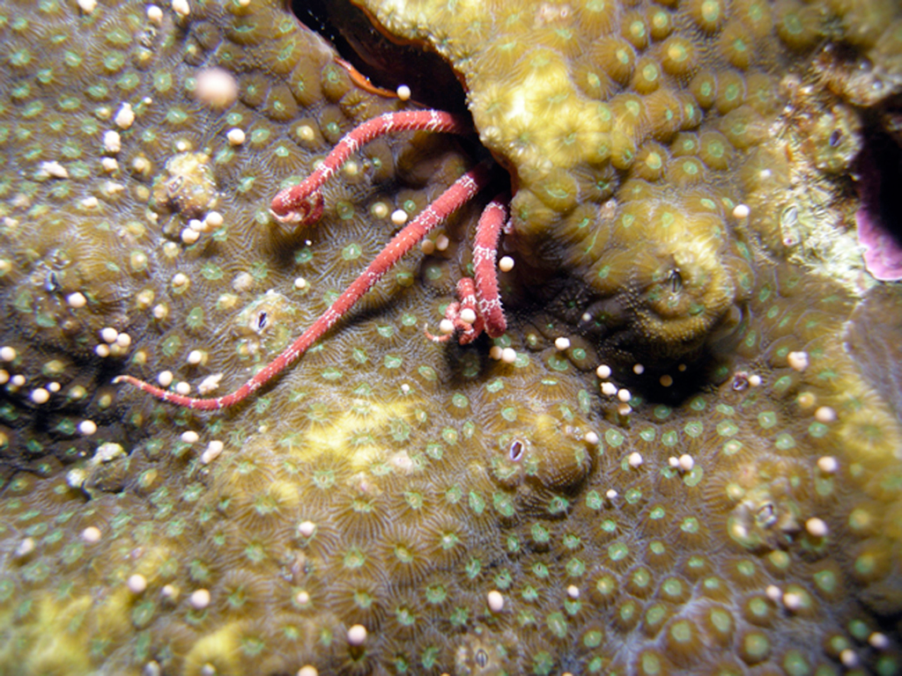

Anatomic Features
tinyurl.com/cgbso7

Slide 8
Immune System
Defense against pathogens
Removal of “worn-out” cells and tissue debris (wound healing and tissue repair)
ID and destruction of abnormal cells that originate in the body.

Slide 9
Immune System
Defense against pathogens
Removal of “worn-out” cells and tissue debris (wound healing and tissue repair)
ID and destruction of abnormal cells that originate in the body.

Slide 10
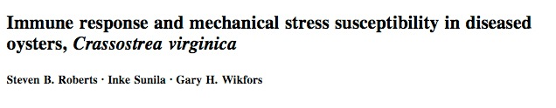

Slide 11
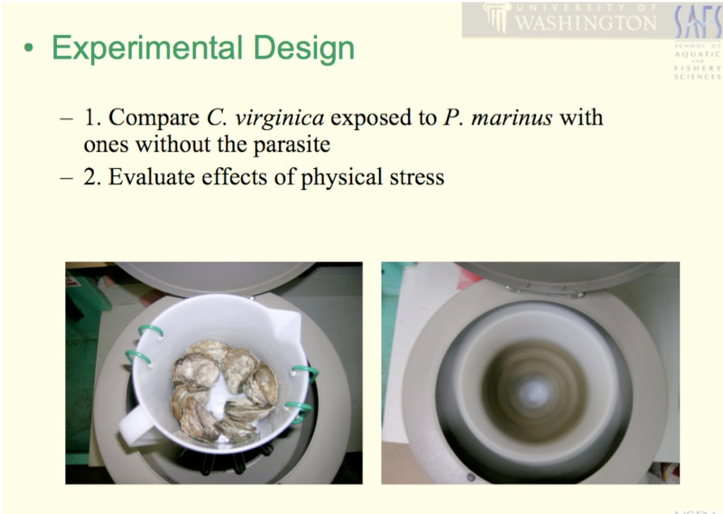

Slide 12
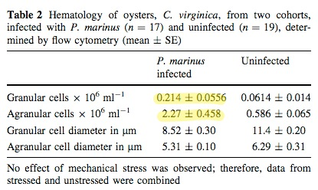
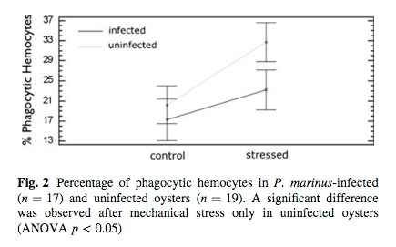

Slide 13
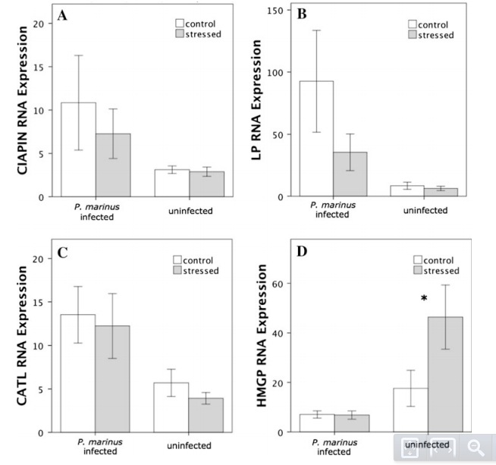

resource
allocation

Slide 14
Pathogens

Slide 15
Introduction to the Immune System of Animals
All organisms are targets for diseases from pathogens, disease-causing organisms
The pathogens include bacteria, parasites, viruses, fungi, and protists
The immune system of the animal fights off the pathogens and keeps the animal healthy

Slide 16
Pathogens
Disease producing power known as ________
Bacteria - release enzymes or toxins
Internal parasites (larger; protozoa, fungi) - use resources, damage tissue
Virus - not self sustaining; lack ability to for energy production and protein synthesis

Slide 17
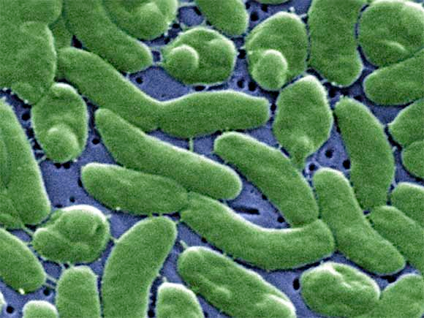
Bacteria - Vibrio

Slide 18
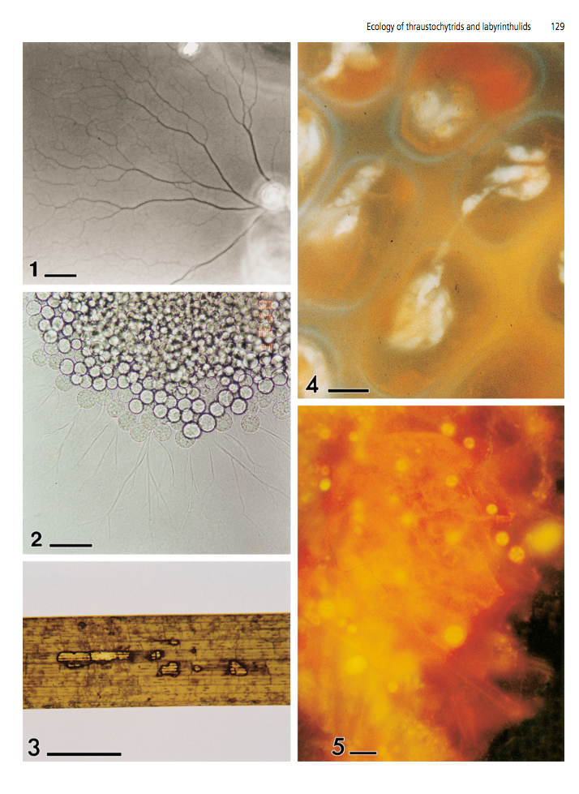
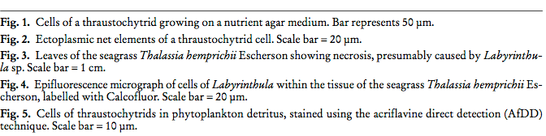
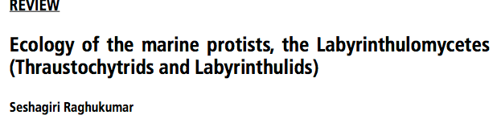
Protists
Fungi-like
Thraustochytrids

Slide 19
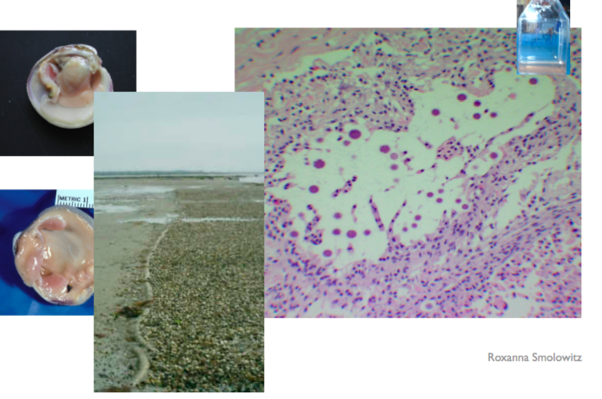
Fungi - QPX

Slide 20
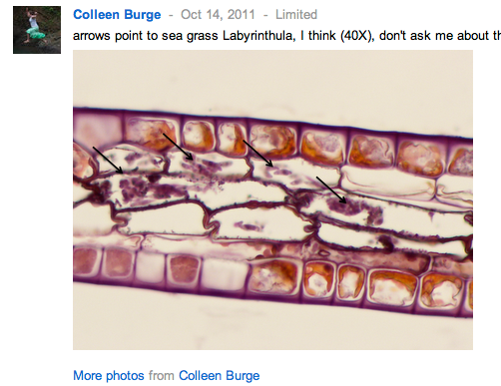

Slide 21
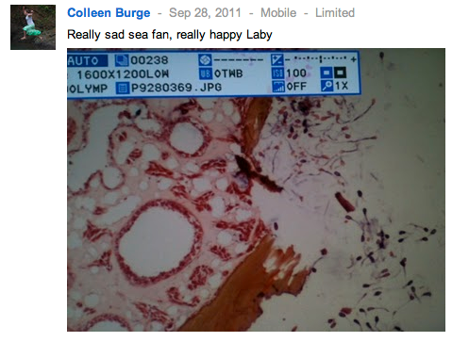
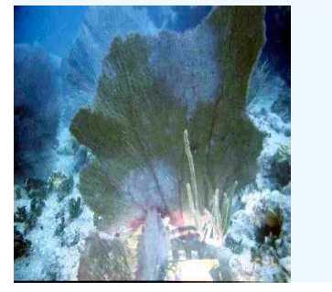

Slide 22

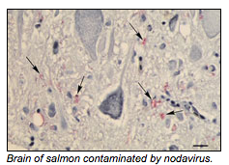
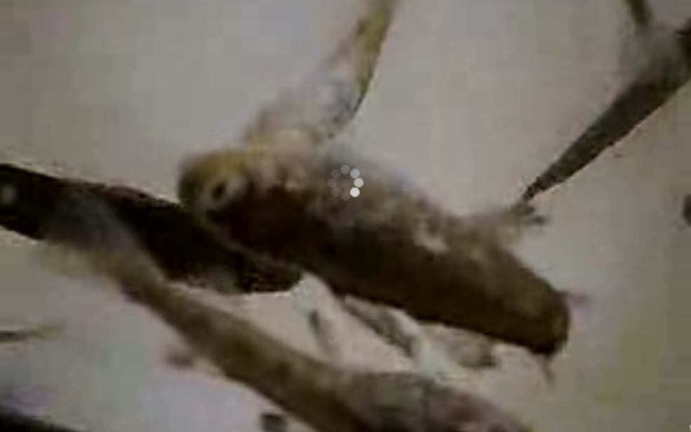

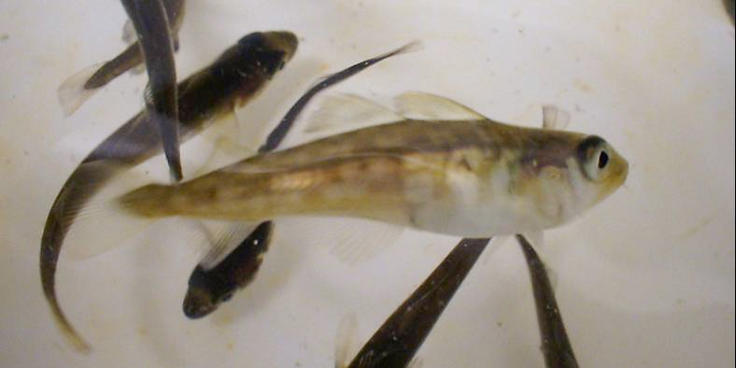
Virus - Nodavirus

Slide 23
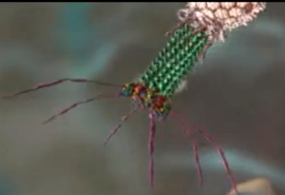
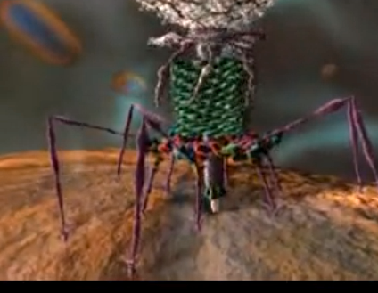
Phage

Slide 24
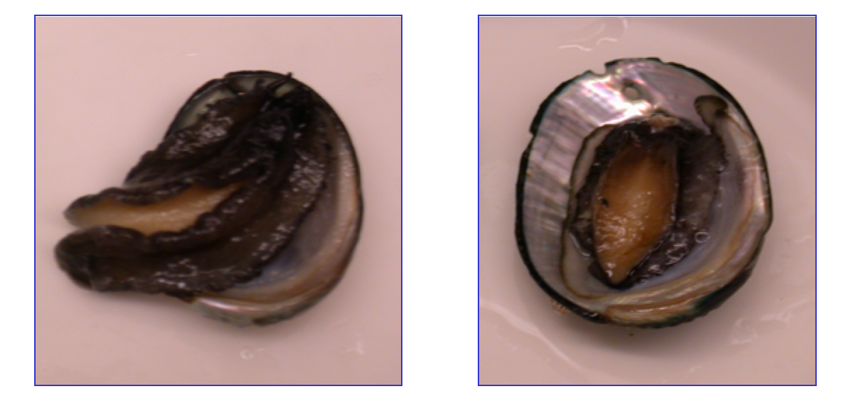
Abalone
Caused by a bacteria..

Slide 25
Introduction
Humans along with other animals are susceptible to a multitude of disease-causing bacteria, viruses, parasitic worms, fungi, and protists
To understand how animals stay healthy for most of their lives, biologists have investigated three observations:
Wounds usually heal, even if they become infected
Most people who contract a bacterial or viral illness eventually recover without medication
People who acquire bacterial or viral infections and recover frequently do not contract the same disease again

Slide 26
Introduction
Immunity is a resistance to or protection against disease-causing pathogens
Prevents individuals from contracting a disease more than once
Immunization is the conferring of immunity to a particular disease
Vaccination is the introduction of a weakened or altered pathogen to prime the body’s immune system, so it fights later infections effectively

Slide 27
Introduction and Some History
In the late 1700s, Edward Jenner had a key insight about why milkmaids often avoided smallpox infections
Because cows suffered from a smallpox-like disease called cowpox, Jenner reasoned that milkmaids were immune to smallpox because they had been exposed to cowpox
To test his hypothesis, he inoculated a boy with cowpox pathogens and then with smallpox pathogens
As predicted, the boy did not contract smallpox

Slide 28
Innate Immunity and Adaptive Immunity
Innate immunity refers to immune system cells that are ready to respond to foreign invaders at all times
The innate immune system is nonspecific and responds in the same way to all antigens
An antigen is any foreign molecule that can initiate an immune response
Cells that require activation confer adaptive immunity
These cells respond in an extremely specific way to the particular strains of bacteria, viruses, or fungi that enter the body

Slide 29
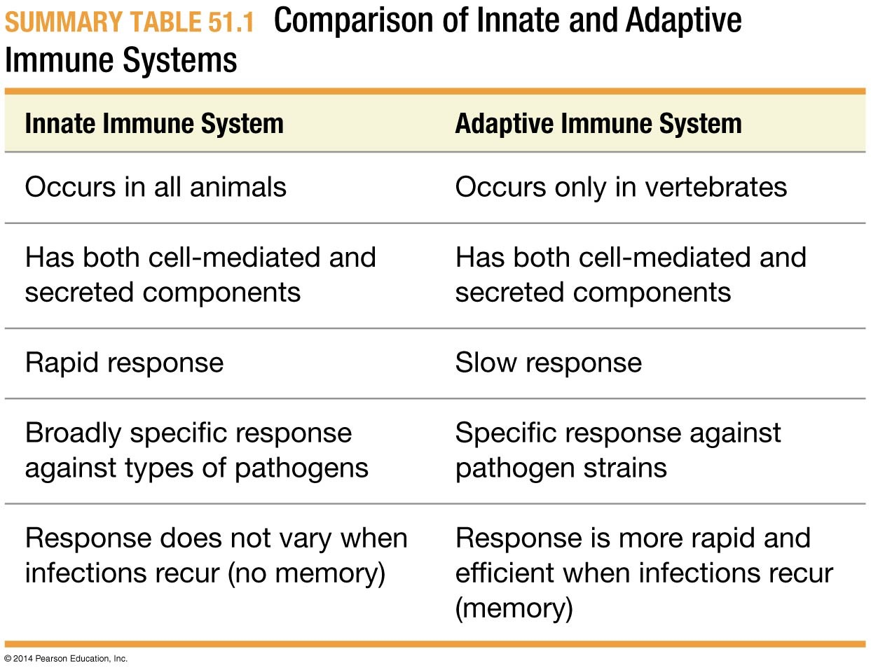
Table 51.1
Notes:
Summary Table 51.1 Comparison of Innate and Adaptive Immune Systems.

Slide 30
Increasingly not as clear

Slide 31

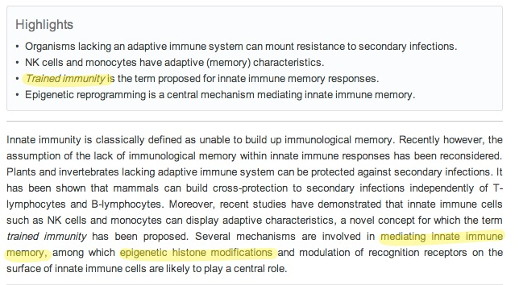
Epigenetics

Slide 32

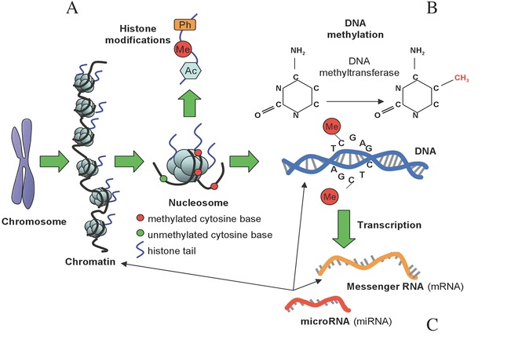
Epigenetics

Slide 33
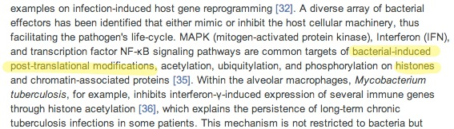
Epigenetics

Slide 34
Barriers to Entry
The most important barrier to pathogen entry is the skin
Skin presents both physical and chemical barriers
A variety of barriers:
Insects have an armored body covering
Soft-bodied animals are generally covered in mucus
Human skin contains a layer of dead cells filled with the protein keratin
Human skin is covered with an oil made of fatty acids.
This lowers the pH, making it difficult for pathogens to grow

Slide 35
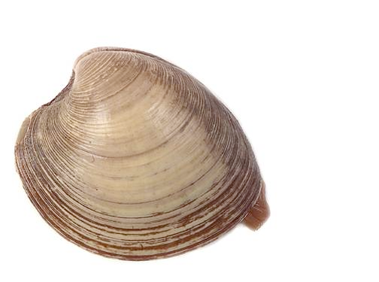
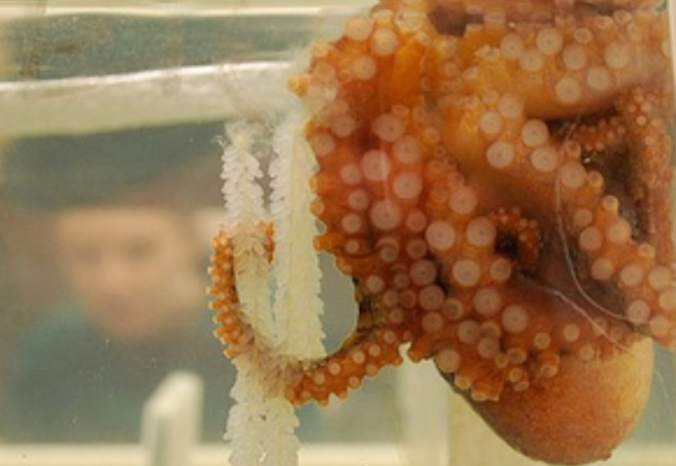
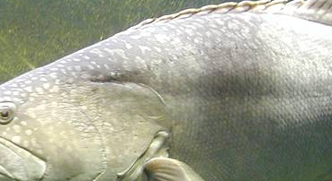
Chemico-physical Barrier
anti-microbial peptides
beneficial microbial communities

Slide 36
How Openings in the Body Are Protected
Gaps have a protective physical barrier in the form of mucus—a proteoglycan-rich solution secreted by epithelial cells—or other features that discourage pathogen entry
This is the same mucus that covers the soft-bodied animals

Slide 37
How Openings in the Body Are Protected
Gaps in the body that are not covered with mucous layers are often protected by other types of secretions, such as wax in the ears and lysozyme, an antibiotic that occurs in tears
Despite preventative measures, however, pathogens are still able to gain entry to tissues beneath the skin

Slide 38
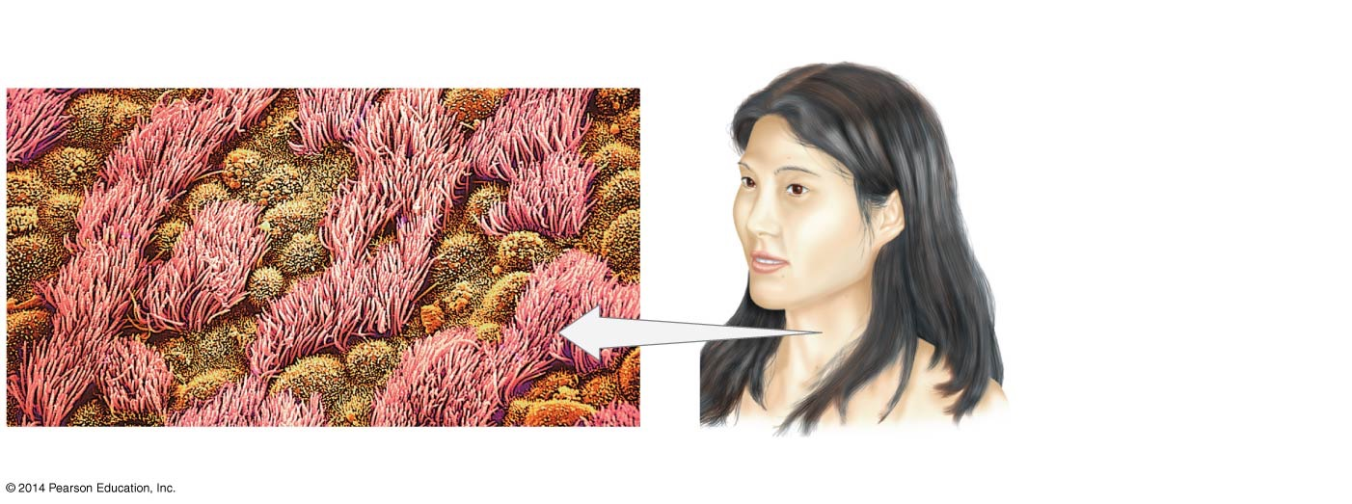
Figure 51.1
Airways (lining of trachea)
Eyes
Most pathogens are trapped in mucus before they can reach the lungs. Beating cilia sweep pathogens up and out of the airway.
Blinking wipes tears across the eye. Tears contain the antibacterial enzyme lysozyme.
Ears
Hairs and earwax trap pathogens in the passageway of the external ear.
Nose
The nasal passages are lined with mucous secretions and hairs that trap pathogens.
Digestive tract
2 μm
Pathogens are trapped in saliva and mucus, then swallowed. Most are destroyed by the low
pH of the stomach.
Mucus-secreting cells
Ciliated cells
Notes:
Figure 51.1 The Body Protects Openings.

Slide 39
How Do Pathogens Gain Entry?
Falls, wounds, and other types of physical trauma provide another important mode of entry
When the skin is broken, bacteria and other pathogens enter
Flu viruses have an enzyme on their surface that disrupts the mucous lining of the respiratory tract
This is how a flu virus gains entry to the respiratory system

Slide 40

Innate Immunity
BLAST Animation: Innate Immunity

Slide 41
The Innate Immune Response
The innate immune response —the body’s nonspecific response to pathogens—involves leukocytes (white blood cells) such as mast cells, macrophages, and neutrophils
Innate immune response leukocytes are alerted to the presence of foreign invaders by antigens that are found on the surfaces of pathogens, but not on host cells

Slide 42
The Innate Immune Response
Two aspects emerge:
The innate response is immediate
Innate response is nonspecific, but will respond to groups of pathogens such as bacteria and fungi

Slide 43
The Toll Protein
Some innate system cells have membrane proteins, known as pattern-recognition receptors, that bind to—and are activated by—pathogen-specific compounds
These proteins serve as “on” switches by initiating a cell response
In humans, the Toll protein has been found
Toll (German for amazing)

Slide 44
The Toll Protein
Toll protein acts as a receptor to a signal that a pathogen is present
Toll responds to antigens, any foreign molecule that enters the body
Toll receptors are part of a group of proteins known as pattern-recognition receptors

Slide 45

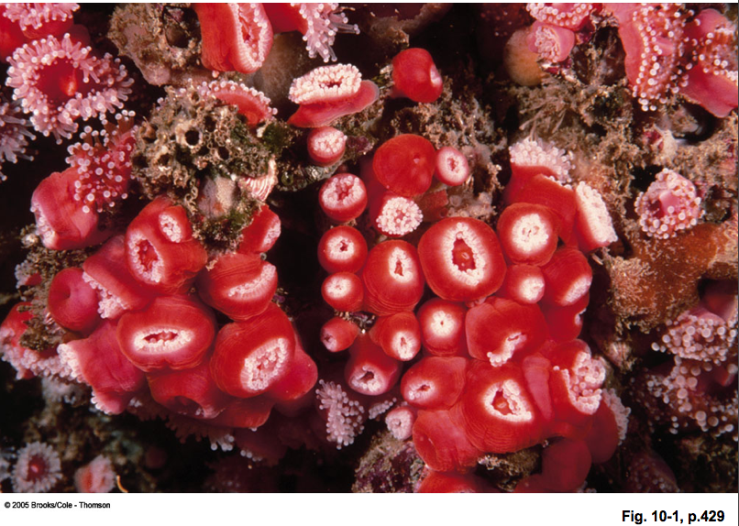

Slide 46
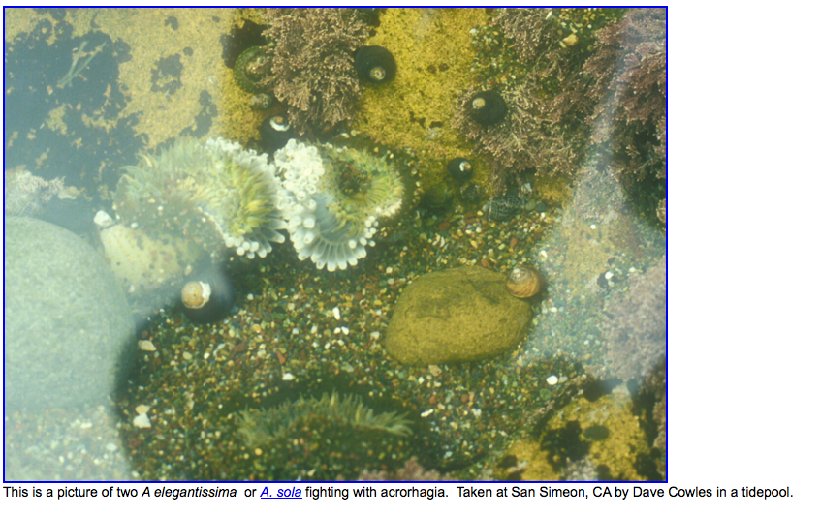

Slide 47
more images @ tinyurl.com/am3ncs
Notes:
similar immune system and organ rejection.

Slide 48
How do organisms distinguish self from non-self?
pattern recognitions proteins (PRPs)
Notes:
sponges can do it.

Slide 49
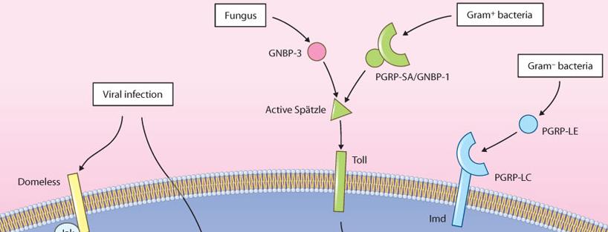
PRPs
Toll-like Receptors
Peptidoglycan recognition proteins

Slide 50
Pattern-Recognition Receptors
Toll receptors (TLRs) are part of a large group of proteins called pattern-recognition receptors
Four of the 11 found in humans are listed here:
TLR2 binds to zymosan, a molecule from fungi
TLR4 captures the lipopolysaccharide (LPS) from the Gram-negative bacteria
TLR5 binds to the flagella of motile bacteria
TLR7 binds to the single-stranded RNA virus

Slide 51
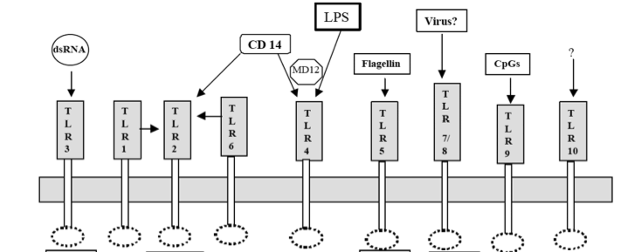
PRPs - Toll-like Receptors

Slide 52
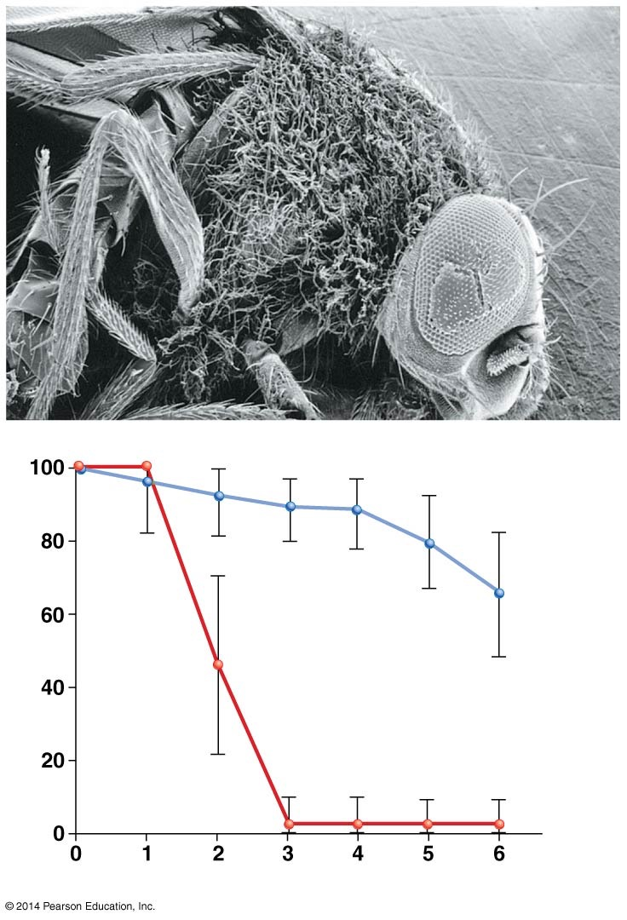
Figure 51.2
Rampant infection of (furry-looking) fungal hyphae in flies that lack the Toll protein
Wild-type flies
Percent survival
Flies that lack the Toll protein
Days after inoculation with fungus
Notes:
Figure 51.2 Toll Protein Is Critical to Immune Response.

Slide 53
Recognition Receptors and Transduction
There are a variety of steps to the recognition and transduction signal produced by the TLR
Flies are an example of the signal production
Step 1. The fly detects a fungus infection
A signal cascade activates the secretion of antimicrobial peptides that act as antibodies

Slide 54
Recognition Receptors and Transduction
Step 2. When human TLR4 is activated, a signal cascade promotes the secretion of cytokines
Cytokines are a group of molecules that are called cell movers
These molecules call other immune cells to the infection site
Step 3. When a virus attacks a cell, TLR7 detects the signal promoting the secretion of a specific cytokine, interferon
The full engagement of the immune system depends on the reception of a signal and an action cascade

Slide 55
Inflammatory Response

Slide 56
The Inflammatory/Innate Response in Humans
The inflammatory response, a multistep innate immune response in mammals, occurs at the site of an injury
The steps of this process are as follows:
When skin breaks, pathogens enter a wound
Platelets release blood-clotting proteins at the wound site
Wounded tissues and macrophages at the wound site secrete chemokines, signaling molecules that recruit immune cells by forming a gradient to mark the path to the site

Slide 57
The Inflammatory/Innate Response in Humans
Mast cells release chemical messengers that constrict blood vessels near the wound—reducing blood flow and thus blood loss
Mast cells also secrete histamine and other signaling molecules, which dilate blood vessels slightly farther away from the wound, making them more permeable
Neutrophils and macrophages remove pathogens by phagocytosis—the engulfing and digesting of foreign particles

Slide 58
The Inflammatory/Innate Immune Response
Macrophages secrete cytokines, chemicals that attract other immune system cells to the site and activate cells involved in tissue repair
They also induce fever—elevated body temperature that aids in healing
The inflammatory response continues until the foreign material is eliminated and the wound is repaired

Slide 59
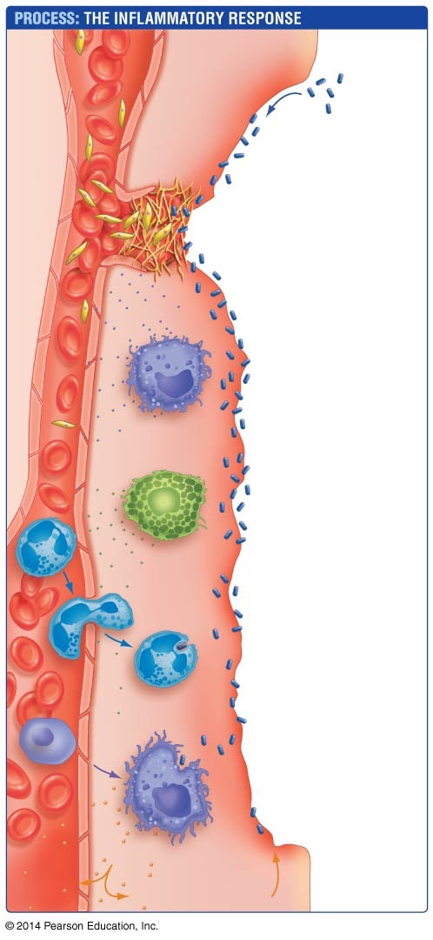



Figure 51.3
Blood vessel
Red blood cell
Platelet
1. Pathogens enter wound.
2. Platelets release blood-clotting proteins.
3. Injured tissues and macrophages release chemokines to recruit help.
Macrophage
4. Mast cells release factors that constrict blood vessels at wound and dilate vessels nearby.
Mast cell
5. Neutrophils arrive and begin phagocytosizing pathogens.
Leaky blood vessel
Neutrophil
6. Other leukocytes arrive and mature into macrophages.
Induce fever, increase leukocyte production
Macrophage
Initiate tissue repair
Notes:
Figure 51.3 The Inflammatory Response of Innate Immunity Has Many Elements.

Slide 60
Innate Immunity in Invertebrates
Innate responses make up the entire immune system observed in millions of species of invertebrates
For example:
If a pathogen succeeds in entering the main body cavity of an insect, cells respond by synthesizing and secreting peptides with potent antibacterial or antifungal properties
Sea stars have specialized cells that are similar in function to neutrophils and macrophages—they secrete cytokines or engulf and destroy pathogens by phagocytosis

Slide 61
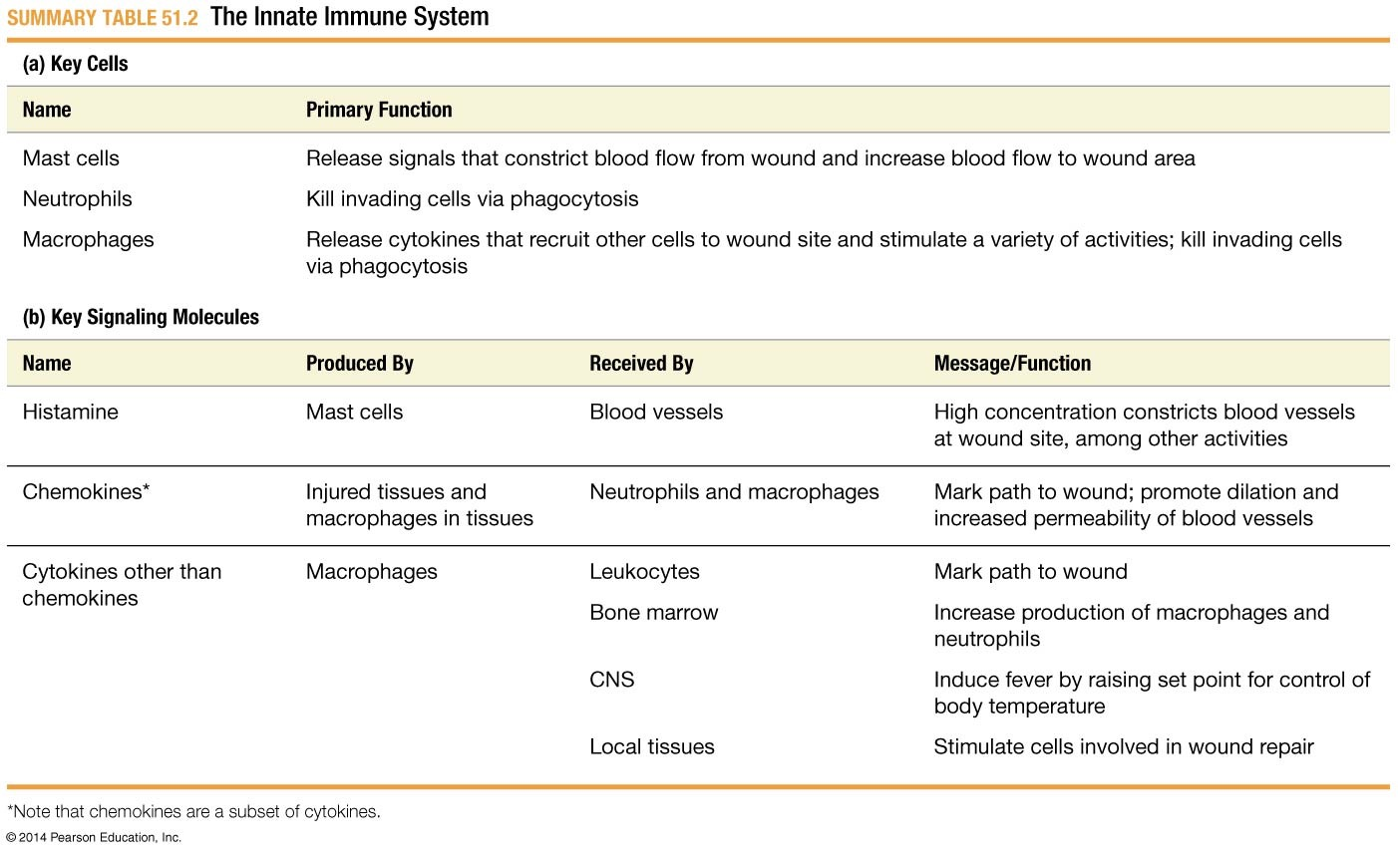
Table 51.2
Notes:
Summary Table 51.2 The Innate Immune System.

Slide 62
The Inflammatory Response
Web Activity: The Inflammatory Response

Slide 63
Adaptive Response

Slide 64
The Adaptive Immune Response: Recognition
The adaptive immune response
Also known as the acquired immune response
Is based on interactions between specific immune system cells and a specific antigen
Antibodies
Are proteins that are produced and secreted by certain lymphocytes
Bind only to a specific part of a specific antigen

Slide 65
The Adaptive Immune Response: Recognition
The four key characteristics of the adaptive immune response are
Specificity—antibodies and other components of the adaptive immune system bind only to specific sites on specific antigens
Diversity—the adaptive response recognizes an almost limitless array of antigens

Slide 66
The Adaptive Immune Response: Recognition
Memory—the adaptive response can be reactivated quickly if it recognizes antigens from a previous infection
Self–nonself recognition—molecules that are produced by an individual do not act as antigens, so the adaptive immune system can distinguish between self and nonself

Slide 67
Lymphocytes

Slide 68
Lymphocytes
The cells involved in the adaptive immune response are called lymphocytes
Contrasting the leukocytes of the innate immune system

Slide 69
Lymphocytes
Lymphocytes are formed, matured, activated, and transported in distinct components of the immune system:
Lymphocytes are produced in bone marrow, a tissue that fills the cavities in bones
Lymphocytes can also originate in the spleen—a lymphatic organ located in the abdominal cavity
Certain lymphocytes (B cells) mature in the bone marrow, but others (T cells) mature in the thymus

Slide 70
The Discovery of B Cells and T Cells
B cells were discovered when researchers were working with an antigen that attacked Salmonella from chickens.
The B cells in chickens are produced in the bursa, an organ that is found in chickens and produces the B cells
The bursa-dependent B cells produce antibodies
Later work showed that B cells mature in bone marrow in humans and other species that lack a bursa

Slide 71
The Discovery of B Cells and T Cells
The thymus-dependent T cells are involved in an array of functions, including recognizing and killing host cells that are infected with a virus

Slide 72
Where Lymphocytes Are Found
Lymphocytes recognize antigens and become activated in the spleen and lymph nodes, small oval organs located throughout he body
Lymphocytes circulate through the blood and the secondary organs of the immune system—lymph nodes, spleen, and lymphatic ducts
Lymphatic ducts are thin-walled, branching tubules that transport lymph throughout the body in the lymphatic system

Slide 73
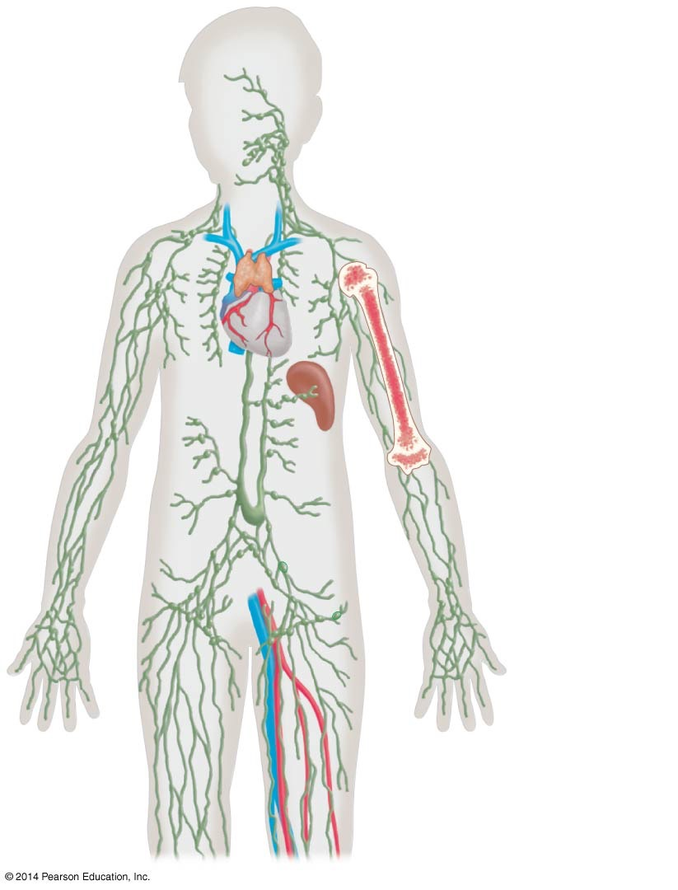
Figure 51.4
Components of the adaptive immune system
Lymphocyte origin: Bone marrow
Lymphocyte maturation:
Bone marrow (B cells)
Thymus (T cells)
Lymphocyte activation:
Spleen
Lymph nodes
Lymphocyte transport:
Lymphatic ducts
Blood vessels
Notes:
Figure 51.4 Lymphocytes Are Formed, Activated, and Transported in the Immune System.

Slide 74
Lymphocytes in Skin Cells and Epithelial Tissue
Large numbers of lymphocytes are also associated with skin cells and with epithelial tissues that secrete mucus—primarily in the digestive tract and respiratory tract
Collectively, immune cells found in the gut and the respiratory organs are called mucosal-associated lymphoid tissue (MALT)
Leukocytes in the skin and MALT are important because they guard points of entry against pathogens

Slide 75
How do the recognize so many different antigens?

Slide 76
The Discovery of B-Cell Receptors
The B-cell receptor (BCR) is the protein on the surface of B cells that binds to antigens
Research has found that this protein has the same structure as the antibodies produced by B cells
This BCR protein consists of two polypeptide chains

Slide 77
The Discovery of B-Cell Receptors
The B-cell receptor has three components:
Two identical light chains—the smaller peptide
Two identical heavy chains that are about twice the size of the light chains
A transmembrane domain within each heavy chain that anchors the protein in the plasma membrane of the B cell

Slide 78
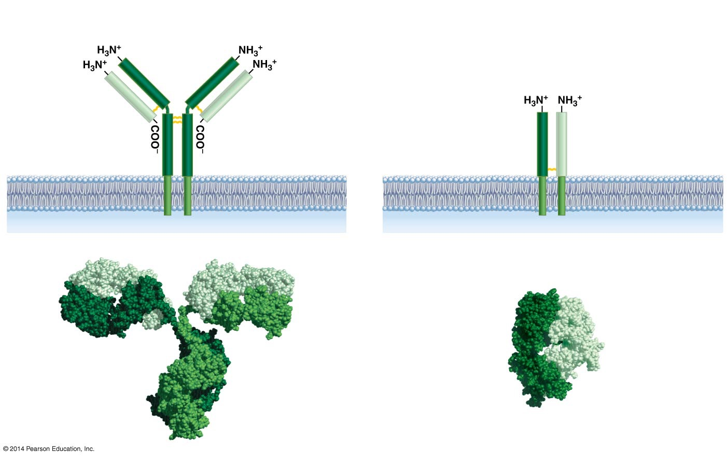
Figure 51.5
(a) B-cell receptor
(b) T-cell receptor
Antigen- binding site
Antigen- binding site
Heavy chains
Antigen-binding site
Light chain
Light chain
α chain
β chain
Disulfide bridge
Transmembrane domains
Transmembrane domains
Light chains
Antigen- binding site
Antigen- binding site
Antigen-binding site
α chain
β chain
Heavy chain
Heavy chain
Notes:
Figure 51.5 B-Cell Receptors and T-Cell Receptors Have Transmembrane Domains and Antigen-Binding Sites.

Slide 79
The Discovery of B-Cell Receptors
Both the BCR and the antibodies produced by B cells belong to a family of proteins called the immunoglobulins (Igs), which are critically important to the adaptive immune response
It is important to note that the antibodies are produced by the B cells but are not anchored to the plasma membrane
Are secreted to move throughout the body

Slide 80
The Discovery of B-Cell Receptors
Five classes of immunoglobulins act as B-cell receptors or antibodies—IgG, IgD, IgE, IgA, and IgM
Each class is distinguished by the heavy chain it contains, and each has a distinct function in the immune response

Slide 81
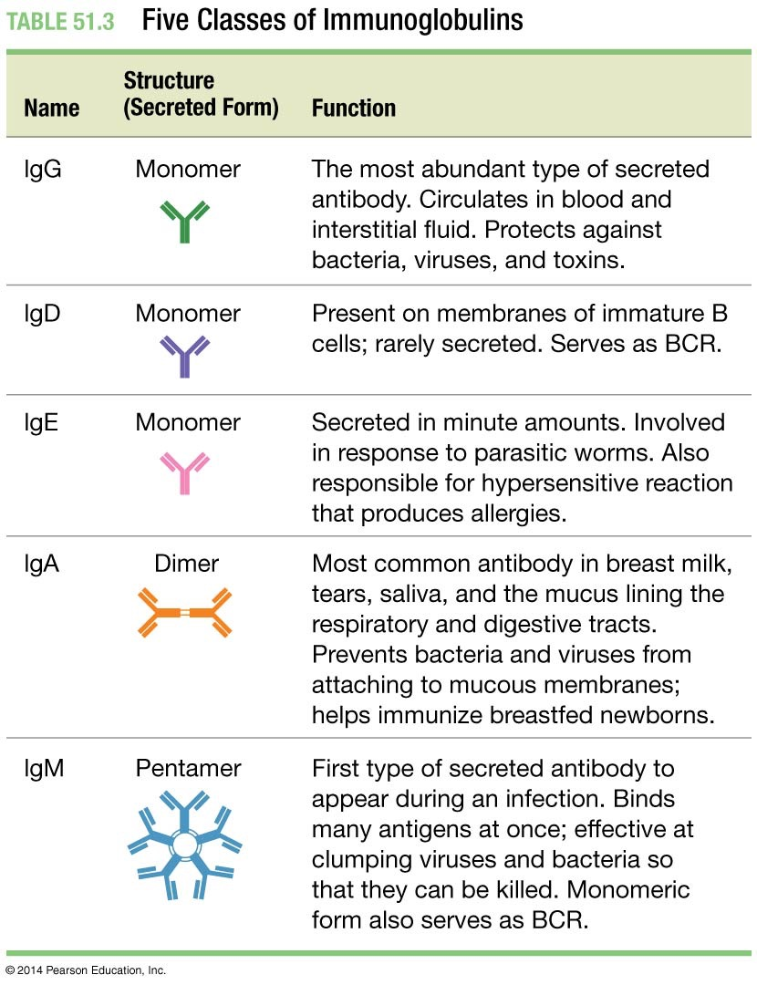
Table 51.3
Notes:
Table 51.3 Five Classes of Immunoglobulins.

Slide 82
The Discovery of T-Cell Receptors
T-cell receptors (TCRs) are proteins on the surface of T cells that bind to antigens
TCRs are made up of an alpha and a beta protein chain, having a shape similar to the BCR “arm”
A process called antigen presentation prepares the T cell to recognize the antigen
T cells bind only to antigens that are displayed by other cells
The difference between a B cell and a T cell is that B cells bind directly to the antigen while T cells need to bind to antigen that are shown by other cells

Slide 83
Antibodies and Receptors Bind to Epitopes
Antibodies, BCRs, and TCRs do not bind to the entire antigen. Instead, they bind to a selected region of the antigen called an epitope
Each epitope is recognized by a particular antibody, BCR, or TCR
It is not unusual for an antigen to have between 10 and 100 different epitopes
For example, the flu virus has an epitope known as hemagglutinin, which is on the surface of the virus
B cells bind directly; T cells bind to processed epitopes

Slide 84
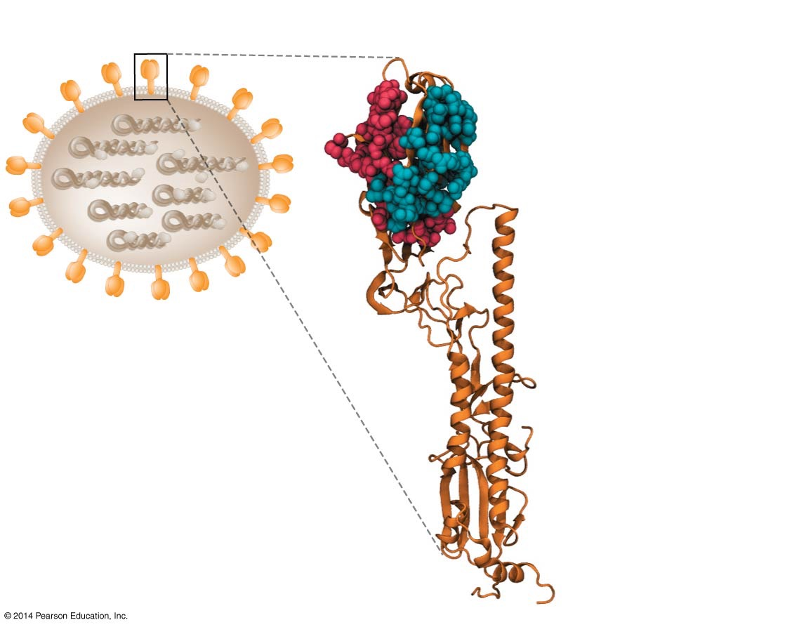
Figure 51.6
Influenza virus
Hemagglutinin protein
Antibody-binding sites (epitopes)
TCR-binding sites (epitopes)
Polypeptide chain of hemagglutinin
Notes:
Figure 51.6 Most Antigens Have Multiple Epitopes for B-Cell Receptors and T-Cell Receptors.

Slide 85
The Molecular Basis of Antibody Specificity and Diversity
Light chains and heavy chains on BCRs and antibodies from different B cells have
One segment in common, the constant (C) region
A segment that is unique to each B cell, the variable (V) region
TCRs also have a variable region near the ends of both of their protein chains

Slide 86
The Molecular Basis of Antibody Specificity and Diversity
The unique, highly variable amino acid sequences in the V regions of every BCR and TCR allow each of them to bind to a unique epitope
Note: The number of BCR, TCR, and antibodies is limitless due to genetic recombination and variation of the amino acid sequence in the V region genes

Slide 87
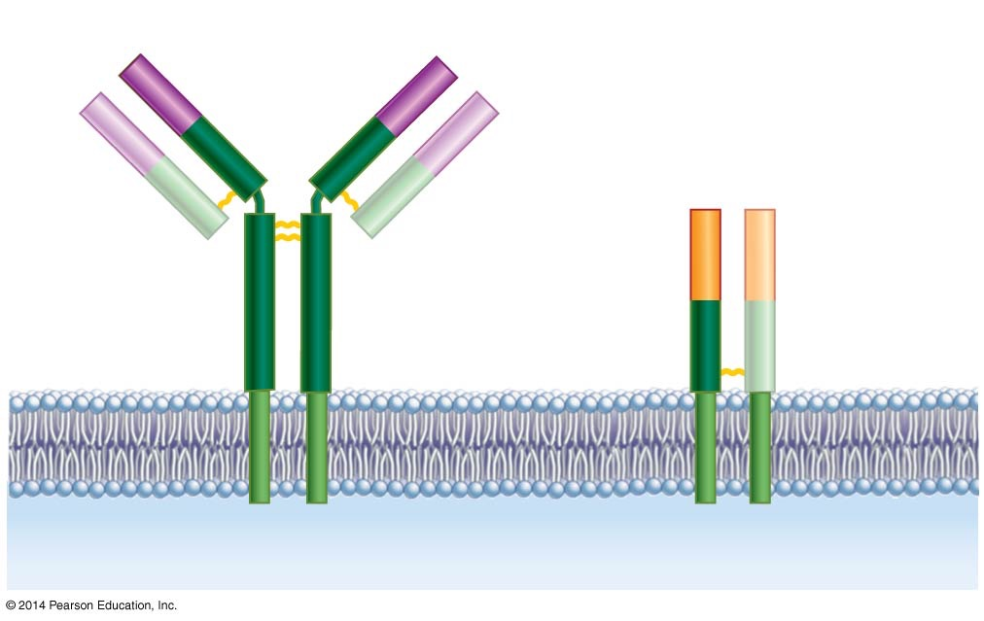
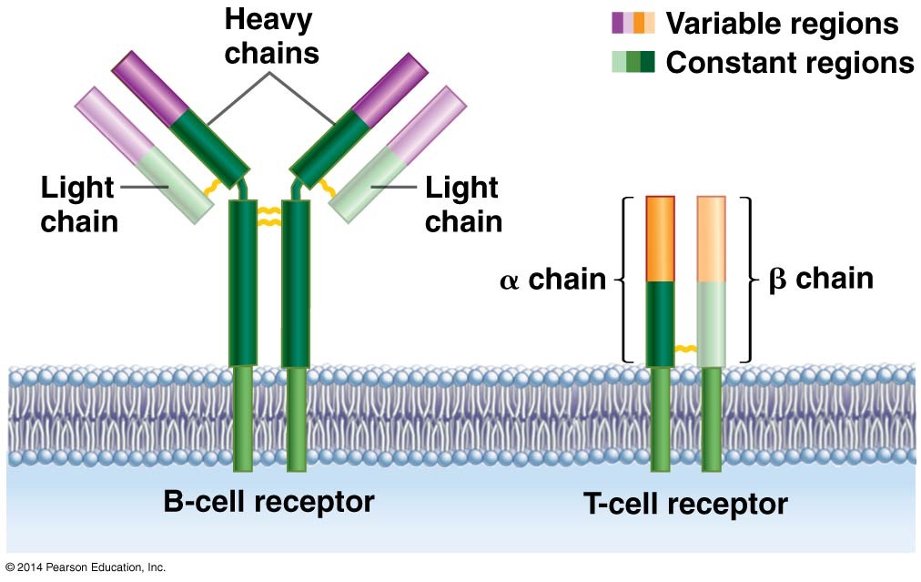
Figure 51.7
Heavy chains
Variable regions
Constant regions
Light chain
Light chain
α chain
β chain
B-cell receptor
T-cell receptor
Notes:
Figure 51.7 The Variable Regions of B-Cell Receptors and T-Cell Receptors Face Away from the Plasma Membrane.

Slide 88
The Discovery of Gene Recombination
W. J. Dryer and J. Claude Bennett hypothesized that during lymphocyte maturation, a variable-region gene segment is cut and combined with a constant-region gene segment, and that this is done differently in each lymphocyte, resulting in each lymphocyte having a unique “V + C gene”
Nobumichi Hozumi and Susumu Tonegawa showed that the amount of DNA in the V + C region of mature lymphocytes is shorter than it is in immature lymphocytes, as predicted by the gene-recombination hypothesis

Slide 89
The Discovery of Gene Recombination
The genes for light chains have
Dozens of different V segments
Several different joining (J) segments
A single constant (C) segment
The heavy-chain gene also has diversity (D) segments
The genes that encode the α and β chains of the TCR have a similar arrangement of distinct segments, each with multiple versions

Slide 90
The Discovery of Gene Recombination
Due to gene recombination, each BCR, antibody, and TCR has a unique amino acid sequence—enabling it to bind a unique epitope on an antigen
Gene recombination is the molecular mechanism responsible for the adaptive immune system’s specificity and diversity

Slide 91
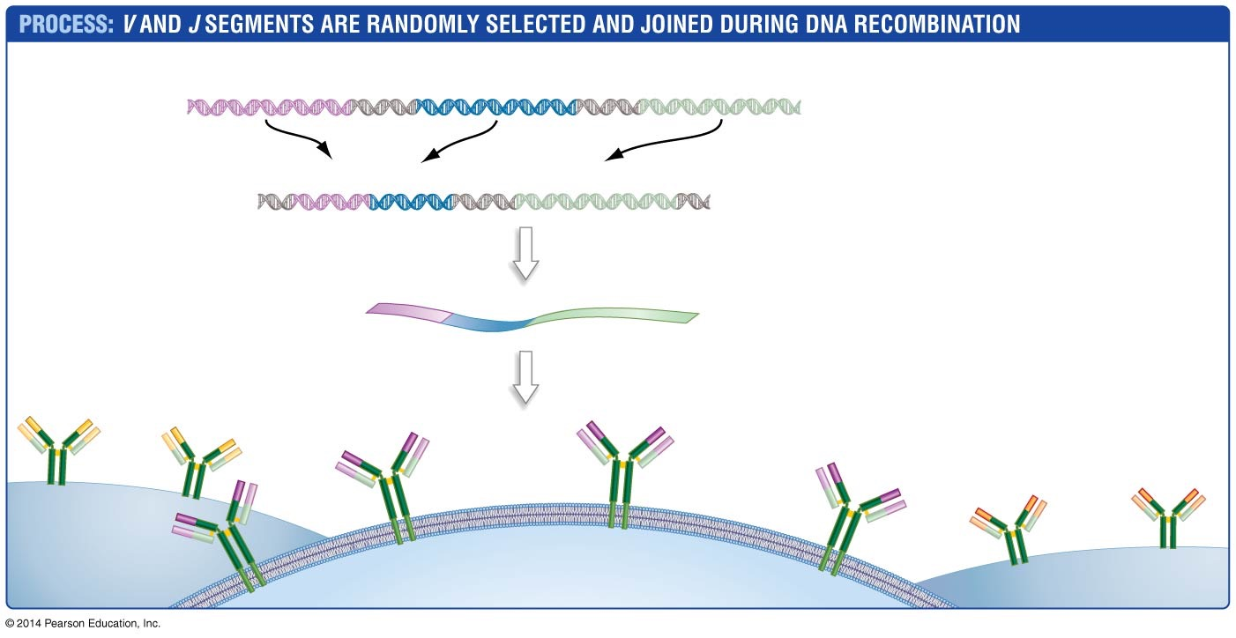
Figure 51.8
V₁ V₂ V₃ …
V₄₀
J₁ J₂ J₃ …
J₅
C
1. Start with full complement of V, J, and C segments.
Light-chain DNA:
V₁₂
J₃
C
2. Recombine (one V, one J, and the C).
Recombined DNA:
V₁₂
C
3. Transcription and RNA processing.
Processed mRNA:
J₃
4. Translation
Light chain
B cell 2
B cell 1
B cell 3
Notes:
Figure 51.8 As B Cells Mature, Immunoglobulin-Gene Segments Recombine to Form a Single Gene.

Slide 92
Self from Nonself, or Autoimmunity
If a B-cell receptor or T-cell receptor responded to a self molecule—a molecule belonging to the host—the receptor would trigger an immune response
An anti-self reaction such as this is known as autoimmunity, which can lead to self destruction
To avoid autoimmunity, anti-self T and B cells are destroyed before they mature

Slide 93
The Immune System Distinguishes Self from Nonself
Examples of autoimmunity:
Multiple sclerosis (MS) results from the production of anti-self T cells that attack the myelin sheath of nerve fibers, resulting in muscular and coordination problems
Rheumatoid arthritis develops when T cells and antibodies alter the lining of joints
Type 1 diabetes mellitus occurs when T cells attack and kill insulin-secreting cells in the pancreas, resulting in an inability to regulate blood glucose levels

Slide 94
Activation

Slide 95
Adaptive Immunity: The Clonal Selection Theory
The clonal-selection theory makes four central claims and explains that lymphocytes become active during an infection
Each lymphocyte has thousands of copies of a unique receptor on its surface. The receptor, a membrane protein, recognizes only one antigen
The lymphocyte is activated when it binds to its specific antigen

Slide 96
The Clonal Selection Theory
An activated lymphocyte divides and makes many identical copies of itself. In this way, specific cells are selected and cloned in response to an infection
Some of the cloned cells descended from an activated lymphocyte persist after the pathogen is eliminated and allow a rapid response if the infection recurs

Slide 97
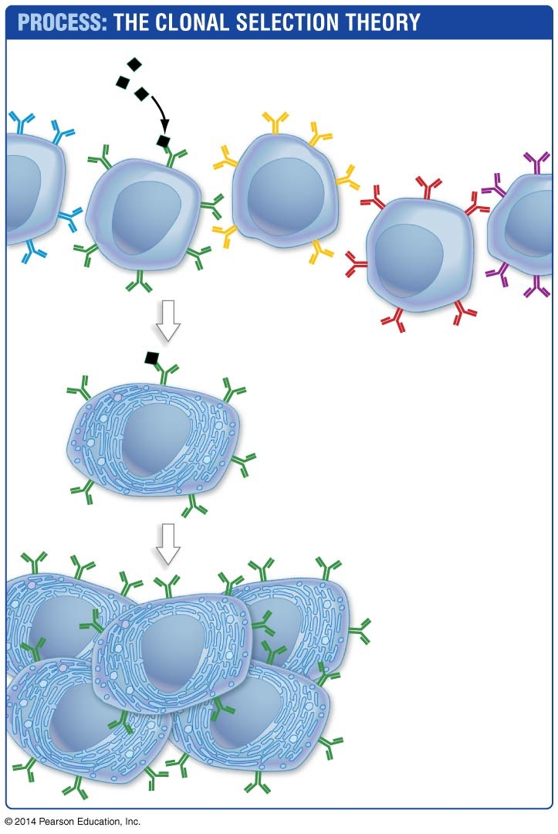
Figure 51.9
Antigens
1. Antigens are recognized by receptors on lymphocytes.
2. Lymphocytes are activated when their receptor binds an antigen.
3. Activated lymphocytes are cloned.
4. Activated lymphocytes endure.
Notes:
Figure 51.9 The Clonal Selection Theory.

Slide 98
Dendritic Cells and MHC Proteins
At first, cells known as dendritic cells attack the antigen
The dendritic cells contain proteins called MHC (major histocompatibility) proteins, antigen-presenting proteins that have a groove where small peptide fragments, typically 8 to 20 amino acids in length, bind
There are two MHC classes:
Class I, which bind antigens inside the ER
Class II, which bind antigens inside endosomes

Slide 99
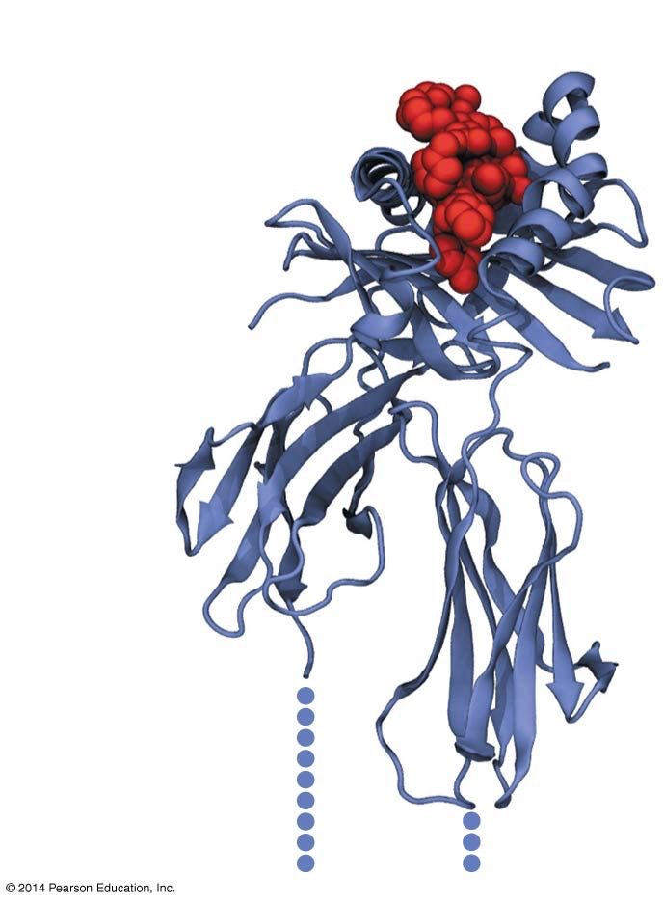
Figure 51.10
Antigen-binding site
Antigen fragment
MHC protein
MHC transmembrane domains
Notes:
Figure 51.10 MHC Structure Promotes Peptide Binding.

Slide 100
Dendritic Cells Arrive at a Wound
When dendritic cells arrive at a wound, five actions occur:
Dendritic cells ingest antigens present at the wound
The antigen enters a membrane-bound compartment inside the cell
An enzyme complex breaks the proteins into pieces, which then become bound to an MHC protein
The MHC–antigen complex is transported to the cell surface
The MHC–antigen complex is displayed on the cell surface

Slide 101
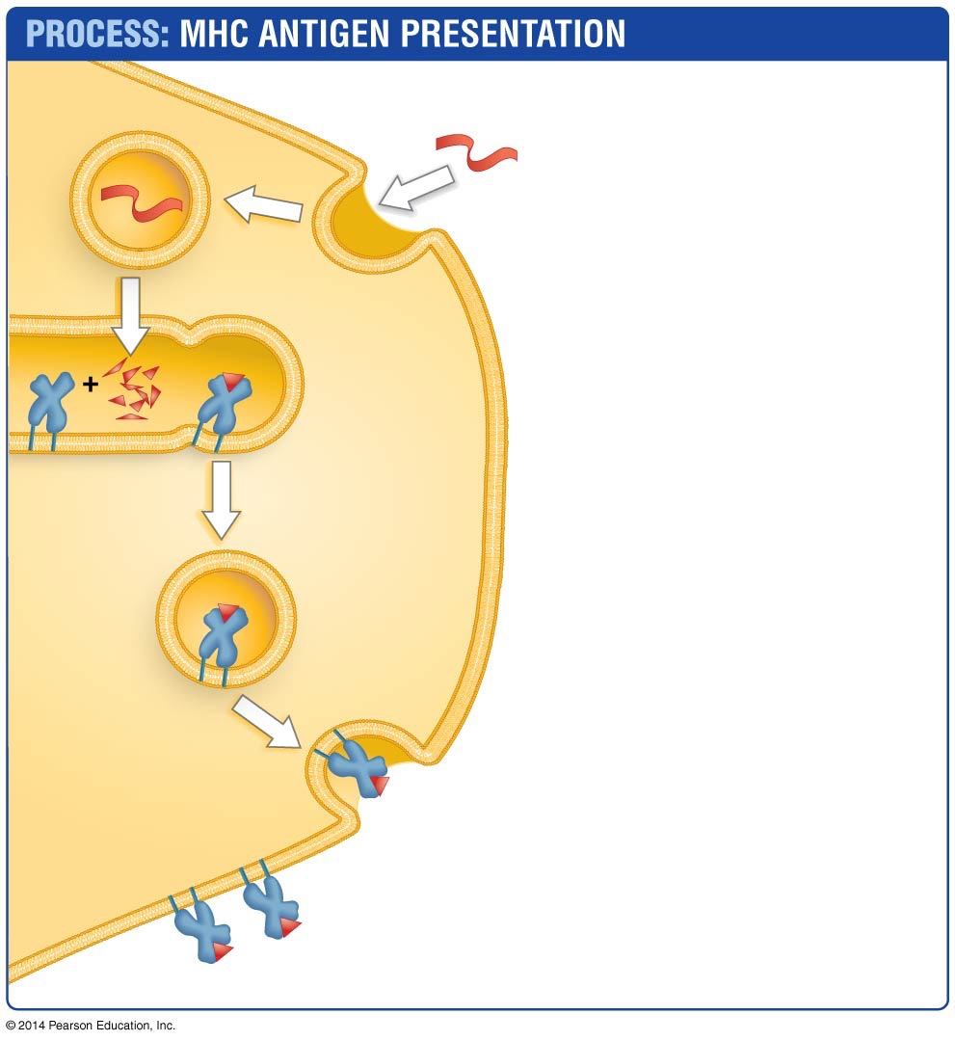
Figure 51.11
Antigen
1. Dendritic cell ingests antigen via phagocytosis.
2. Enzymes break antigen into peptide fragments.
Antigen fragment
Major histo- compatibility (MHC) protein
3. Peptides are loaded onto MHC in endosomes.
4. MHC–peptide complex is transported to cell surface.
Dendritic cell
MHC
5. MHC protein presents peptide on cell surface.
Piece of antigen
Notes:
Figure 51.11 Dendritic Cells Present Antigens.

Slide 102
Antigen Presentation by MHC Proteins
Humans have several genes encoding class I and class II MHC proteins and thus can produce several distinct proteins of each type
In addition, virtually all cells in the body display pieces of “self” proteins, bound to MHC class I proteins, on their surfaces. These are signs that indicate, “I’m a self-cell”
Foreign cells that do not display these signs are destroyed by components of the innate immune system

Slide 103
T-Cell Activation—The First Step
Lymphocyte activation begins when antigens are taken up by a specific type of leukocyte or an infected cell, cut into pieces, packaged with specific cell proteins, and transferred to the cell surface
T cells then bind to the antigens via the TCR and begin the activation process
Antigen-presenting cells interact with T lymphocytes called CD8⁺ T cells
T cells are classified as CD4⁺ or CD8⁺, based on the presence of CD4 or CD8 proteins on their plasma membranes

Slide 104
T-Cell Activation
In the lymph organs, antigen-displaying dendritic cells interact with T cells
CD8⁺ T cells interact with MHC–class I–bound antigens
CD4⁺ T cells interact with MHC–class II–bound antigens
To the T cell, the antigen-presenting cell carries the message “I’ve found antigen—response required”

Slide 105
T-Cell Activation
Activated T cells undergo clonal expansion—they divide to produce a series of genetically identical daughter cells, leading to a large lymphocyte population capable of responding to a specific antigen

Slide 106

Figure 51.12
Dendritic cell
1. T-cell receptor binds to antigen presented on MHC, becomes activated.
MHC class I
Antigen
MHC class II
CD8⁺ T cell
CD4⁺ T cell
Clonal expansion
Cytotoxic T cells
2. Activated T cells multiply, differentiate, and enter blood.
Cytokines
Helper T cells
Notes:
Figure 51.12 T Cells Are Activated by Interacting with MHC–Peptide Complexes.

Slide 107
Cytotoxic T Cells and Helper T Cells
When activated CD8⁺ T cells undergo clonal expansion, the daughter cells develop into cytotoxic T cells, or killer T cells
Cytotoxic T cells interact only with host cells that display antigens presented on class I MHC proteins, which signals that the cell is infected and should be sacrificed
When a cell displays an antigen bound to a class I MHC protein, it sends a simple message to cytotoxic T cells: “Kill me”

Slide 108
Cytotoxic T Cells and Helper T Cells
The daughter cells of activated CD4⁺ T cells differentiate into helper or effector T cells that help to activate other lymphocytes
There are two types of helper T cells:
T_{H}1—activate the killer cells
T_{H}2—activate the B cells

Slide 109
Cytotoxic T Cells and Helper T Cells
Helper T cells interact only with lymphocytes that display antigens presented on Class II MHC proteins, which signals they should be activated
If a leukocyte displays an antigen on a class II MHC protein, the message to helper T cells is “Activate now”

Slide 110
B-Cell Activation and Antibody Secretion
CD8⁺ and CD4⁺ lymphocytes are activated by interactions with antigen-presenting leukocytes
When fully activated, the B cell produces large amounts of RER and mitochondria

Slide 111
B-Cell Activation and Antibody Secretion
B-cell activation involves four steps:
A B cell encounters and binds to a foreign protein in a lymph node or the spleen
The B cell internalizes and processes the molecule, and presents it on the cell surface by an MHC class II protein
The B cell activates the helper T cell when the antigen complex interacts with receptors on the helper T cell

Slide 112
B-Cell Activation and Antibody Secretion
The activated helper T cell releases cytokines, which activate the B cell
The activated B cell begins to divide
Some daughter cells differentiate into plasma cells, which produce large quantities of antibodies
Antibodies specific to the pathogen will circulate in the blood and will bind to those antigens and mark them for destruction

Slide 113

Figure 51.13
(a) Inactive lymphocyte
Nucleus
1 μm
(b) Activated lymphocyte
Large amount of rough ER
Mitochondria
Nucleus
1 μm
Notes:
Figure 51.13 Lymphocytes Exist in Two States: Inactive and Activated.

Slide 114


Figure 51.14
Foreign protein
B-cell receptors
1. B cell recognizes invader.
B-cell
MHC class II protein
2. B cell stimulates active T cell.
B cell
3. B cell is activated by helper T cell.
Cytokines
Helper T cell
4. Activated B cell divides, produces plasma cells, which produce antibodies.
Plasma cells
Antibodies will bind to antigens and mark them for destruction
Antibodies
Notes:
Figure 51.14 B Cells Are Activated by Binding to Antigens and Interacting with Helper T Cells.

Slide 115
The Adaptive Immune Response: Culmination
In combination with the leukocytes involved in the innate immune system, the cells of the adaptive immune system are almost always successful in eliminating threats from bacteria, parasites, fungi, and viruses.
The adaptive immune response has two mechanisms:
Cell-mediated involves T_{H}1 and cytoxic T cells and occurs by cell-to-cell communication
The humoral response promoted by T_{H}2 cells, which secrete antibodies into blood and lymph

Slide 116
Response

Slide 117
How Are Bacteria and Other Foreign Cells Killed?
When antibodies coat foreign cells, the result is agglutination (clumping of bacteria)
Cells that are agglutinated are readily phagocytized by macrophages
Clumped and single cells that are tagged with antibodies are readily destroyed by macrophages via phagocytosis
Antibodies that are bound to antigens also stimulate a lethal group of proteins called the complement system
A combination of the innate and adaptive immune responses usually eliminates all invading bacteria within a few days

Slide 118
Eliminating Extracellular Pathogens
Bound antibodies eliminate pathogens in four ways:
Opsonization is the coating of the pathogen and its destruction by phagocytes
Neutralization is the blocking of coated cells from interacting with host cells
Agglutination is the clumping of antigens by antibodies

Slide 119

Figure 51.15
Complement protein
Pathogen
Antibody
Neutrophil
Uninfected host cell
Opsonization
Neutralization
Agglutination
Co-stimulation of complement proteins
Notes:
Figure 51.15 The Humoral Response Eliminates Extracellular Pathogens.

Slide 120
Eliminating Extracellular Pathogens
Co-stimulation of complement proteins is the activation of a group of proteins called the complement system
The proteins have two functions:
Assembling antigen–antibody complex
Creating holes in the plasma membranes of the pathogens

Slide 121


Complement System

Slide 122
How Are Viruses Destroyed?
The immune system has two major ways to eliminate viruses:
The cell-mediated response involves cytotoxic T cells (activated CD8⁺ cells) and takes place at the surface of infected cells
The humoral response involves antibodies and takes place in blood and lymph

Slide 123
The Cell-Mediated Response
In the cell-mediated response, cells that display viral antigens bound to class I MHC molecules are recognized by activated CD8⁺ cells
These cytotoxic T cells bind to the virus-infected cell, produce pores in the membrane, and activate a self-destruct response
Because viruses can reproduce only inside host cells, the cell-mediated response limits the spread of infection by preventing new generations of virus particles from maturing

Slide 124
The Humoral Response
In the humoral response, antibodies coat free virus particles so that they cannot infect cells
Two things happen once antibodies bind to the outside of a virus:
The virus is blocked from infecting host cells
Macrophages and other phagocytic cells recognize the antibody-coated particles and phagocytize them
Eventually, the virus population is reduced to zero

Slide 125

Figure 51.16
Cytotoxic T cell
Apoptosis- activating proteins
Pore- forming proteins
Granules
Macrophage
MHC protein
T cell
Virus- infected cell
Infected cell
Pores
1. Cytotoxic T cell recognizes and binds infected cell.
2. T cell secretes pore-forming proteins and other proteins that are transported into the infected cell.
3. Infected cell breaks up into fragments. Phagocytic cells consume the fragments.
Notes:
Figure 51.16 The Cell-Mediated Response Eliminates Intracellular Pathogens.

Slide 126
Adaptive Immunity
BLAST Animation: Adaptive Immunity

Slide 127
The Immune System Rejects Foreign Tissues and Organs during Transplants
Transplanted tissues and organs contain antigens that are recognized as foreign, and an immune response is mounted, leading to rejection of the organ and the possible death of the patient
To prevent strong immune reactions, physicians do two things:
Obtain the organ to be transplanted from a sibling or other donor whose MHC proteins are extremely similar to those of the recipient
Treat the recipient with drugs that suppress the immune response

Slide 128
Responding to Future Infections: Immunological Memory
Activated B cells and T cells produce specialized daughter cells called memory cells that do not participate in the primary immune response
This system is known as immunological memory
Memory cells provide for a secondary immune response if the same antigen enters the body again

Slide 129
Responding to Future Infections: Immunological Memory
Circulating memory T and B cells increase the likelihood that lymphocytes with the correct antigen-specific receptors will find the antigen and activate quickly
Therefore, the secondary response is faster and more efficient than the primary response

Slide 130
The Secondary Response Is Strong and Fast
The ability of memory B-cell receptors to bind to the antigen’s epitope results in a process called somatic hypermutation, which fine-tunes the immune response
Memory B cells with receptors that bind best to the antigen’s epitope live and produce daughter cells; those that bind to the antigen less effectively die
The antibodies that result from somatic hypermutation are better fitting than the antibodies produced by plasma cells during the primary immune response

Slide 131

Figure 51.17
Initial exposure to antigen
Second exposure to antigen
Secondary immune response
Response is larger
Antibodies in blood (arbitrary units)
Primary immune response
Response is faster
Time (days after exposure)
Notes:
Figure 51.17 The Secondary Immune Response Is Faster and Stronger than the Primary Response.

Slide 132

Table 51.4
Notes:
Summary Table 51.4 Activation and Function of Adaptive Immune System Cells.

Slide 133
The Adaptive Immune Response
Web Activity: The Adaptive Immune Response

Slide 134
Why Does Vaccination Work?
A vaccine contains antigens from a pathogen or a killed or weakened version of the pathogen itself
There are three types of vaccines:
Subunit vaccines, such as those for hepatitis B and influenza, consist of isolated viral proteins
Inactivated viruses, used in hepatitis A and polio, have been damaged by chemical treatments or exposure to ultraviolet light. They do not cause infections, but are antigenic

Slide 135
Why Does Vaccination Work?
Attenuated, or “live” viruses consist of complete virus particles that have lost the ability to grow rapidly in their normal host cells. The smallpox, polio, and measles vaccines consist of attenuated viruses
After vaccination (inoculation with a vaccine), the body mounts a primary immune response that produces memory cells. If a second infection occurs later, these memory cells respond quickly and eliminate the threat before illness appears

Slide 136
Failure of the Immune System
Viruses such as influenza and the human immunodeficiency virus (HIV) mutate so rapidly that they present the immune system with a constantly changing array of epitopes
Memory cells that were effective during a previous infection by these viruses are unlikely to bind to the changed epitopes and trigger a response to a later infection
As a result, it is extremely difficult to design an effective vaccine against these agents

Slide 137
What Happens When the Immune System Fails?
Individuals with badly impaired adaptive immune systems suffer debilitating illness from infections
The immune system can fail by not reacting or by overreacting to a particular antigen
For example: People infected with the human immunodeficiency virus (HIV) suffer a progressive loss of CD4⁺ T cells because HIV kills CD4⁺ T cells and macrophages
Eventually, HIV-infected people develop AIDS—acquired immune deficiency syndrome

Slide 138
Allergies
An allergy, or allergic reaction, is an abnormal over-reactive response to an antigen
Certain people produce IgE antibodies—which are normally produced only in response to infection by worms—in response to specific molecules found in cat dander, nuts, plant pollen, or other products
Molecules that trigger this response are called allergens instead of antigens

Slide 139
Allergies
The presence of IgE antibodies in an allergic response triggers a series of events known as the hypersensitive reaction
When a person is first exposed to an allergen, receptors on certain leukocytes bind to the IgE antibodies that are produced
Once this binding event occurs, the cells (and the person) are said to be sensitized
Subsequent exposure to the allergen results in the onset of allergy symptoms

Slide 140
Allergies
Later exposure causes the sensitized cells to produce large quantities of histamine, cytokines, chemokines, and other substances that all result in dilation and increased permeability of blood vessels, contraction of smooth muscles, and secretion by mucus-producing cells
A potentially lethal reaction called anaphylactic shock can occur if the immune response is very severe

Slide 141
Immunodeficiency Diseases
Immunodeficiency diseases badly impair the adaptive immune response
Children can be born with a genetic disorder known as severe combined immunodeficiency disease (SCID)
This is caused by mutations on the X chromosome
The mutation interferes with the development of T cells
In Omenn syndrome, a genetic defect interferes with the recombinant DNA responsible for the T-cell and B-cell receptor production

